Slide 1
Ibrutinib, Single Agent or in Combination With Dexamethasone, in Patients With Relapsed or Relapsed/Refractory Multiple Myeloma (MM): Preliminary Phase 2 Results
Abstract 31
Vij R, Huff CA, Bensinger WI, Siegel DS, Jagannath S, Berdeja JG, Lendvai N, Lebovic D, Anderson LD, Costello CL, Stockerl-Goldstein KE, Laubach JP, Elias L, Clow F, Fardis M, Graef T, Bilotti E, Richardson PG

Slide 2
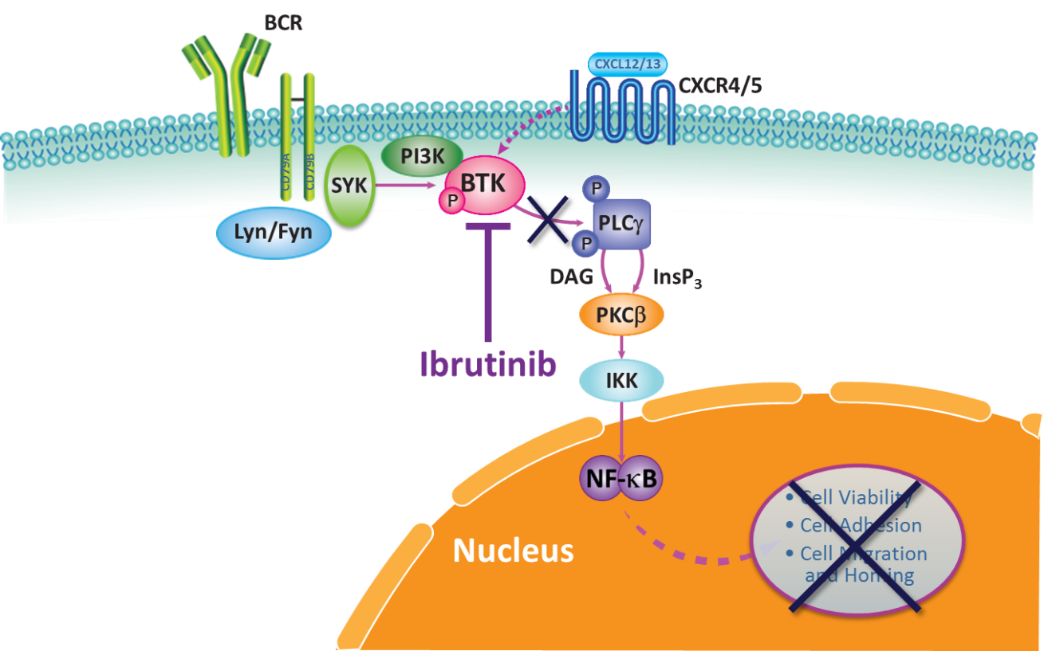
Introduction
MM remains an incurable disease in need of new therapies
Ibrutinib is a first-in-class, once-daily, oral, covalent inhibitor of BTK, an essential enzyme in B-cell receptor signaling^{1,2}
Ibrutinib has shown substantial clinical activity in CLL and MCL²⁻⁴
In MM, ibrutinib may target both the MM cells and the microenvironment
BCR
CXCR4/5
DAG
InsP₃
Simplified pathway adapted from 5,6
1. Honigberg LA, et al. Proc Natl Acad Sci U S A. 2010:107(29):13075-13080; 2 .Byrd JC, et al. N Engl J Med. 2013;369(13):1278-1279; 3. Byrd JC, et al. N Engl J Med. 2014;371(3):213-223; 4. Wang ML, et al. N Engl J Med. 2013;369(6):507-516; 5. Buggy JJ, et al. Int Rev Immunol. 2012;31(2):119-132; 6. de Rooij MF, et al. Blood. 2012;119(11):2590-2594.
Vij R, et al. Blood. 2014;124: Abstract 31.

Slide 3
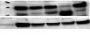
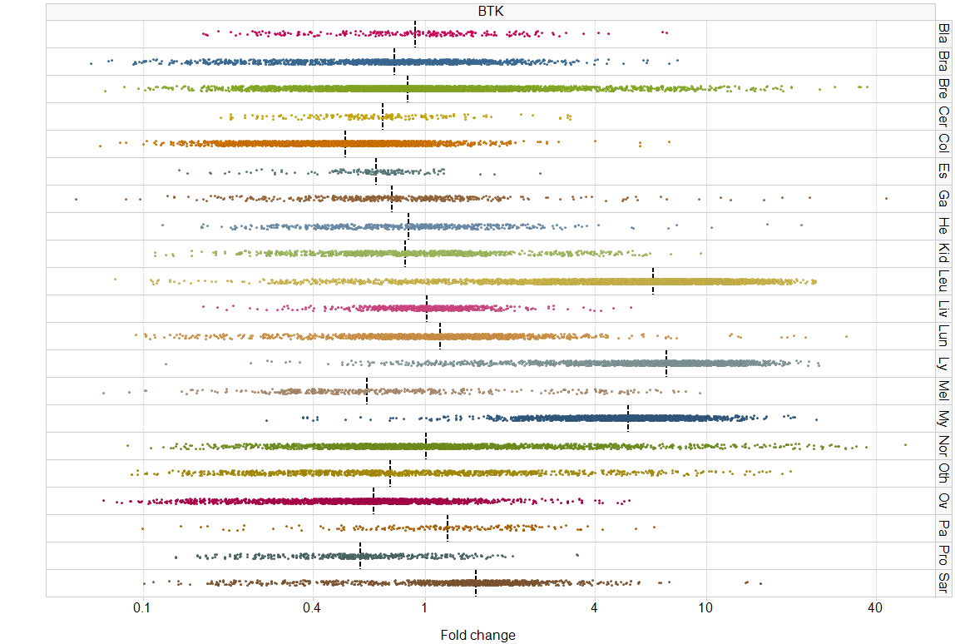
BTK Expression in MM Plasma Cells
BTK is a nonreceptor tyrosine kinase that is expressed in many hematopoietic lineages and plays a critical role in B-cell maturation^{1,2}
Increased BTK expression in MM plasma cells compared with normal plasma cells is not expected
However, recent studies showed robust BTK expression in the majority of MM plasma cells in patients with MM^{1,2}
Patient MM cells¹
marker
Overexpression
1
2
3
4
5
Relative BTK expression
BTK
Myeloma
Normal
α-tubulin
0.1
0.4
1
4
10
40
Fold Change
1. Tai YT, et al. Blood. 2012;120(9):1877-1887. 2. Bam R, et al. Am J Hematol. 2013; 88(6):463-471.
Vij R, et al. Blood. 2014;124: Abstract 31.

Slide 4
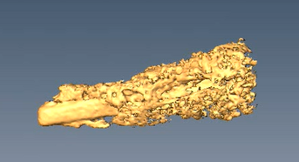
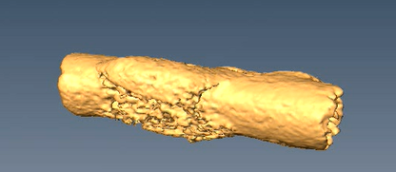
Impact of BTK Inhibition on Bone
BTK is expressed on osteoclasts (OC) but not osteoblasts (OB)¹
BTK activation mediates osteoclastogenesis induced by M-CSF and RANKL^{1,2}
Ibrutinib inhibited osteolytic activity by OC in vitro and decreased OC cytokine secretion¹
Ibrutinib suppressed bone resorption activity by OC in SCID-hu animals implanted with MM cells¹
Control¹
Ibr¹
Bone Mineral Density¹
Increase of OB¹
400
*
20
**
300
15
200
Fold Change (ALP+/BS)
BMD (mg/cc)
10
100
5
0
0
Control
Ibr
Control
Ibr
*P < .04; **P < .01
1. Tai YT, et al. Blood. 2012;120(9):1877-1887. 2. Bam R, et al. Am J Hematol. 2013; 88(6):463-471.
Vij R, et al. Blood. 2014;124: Abstract 31.

Slide 5
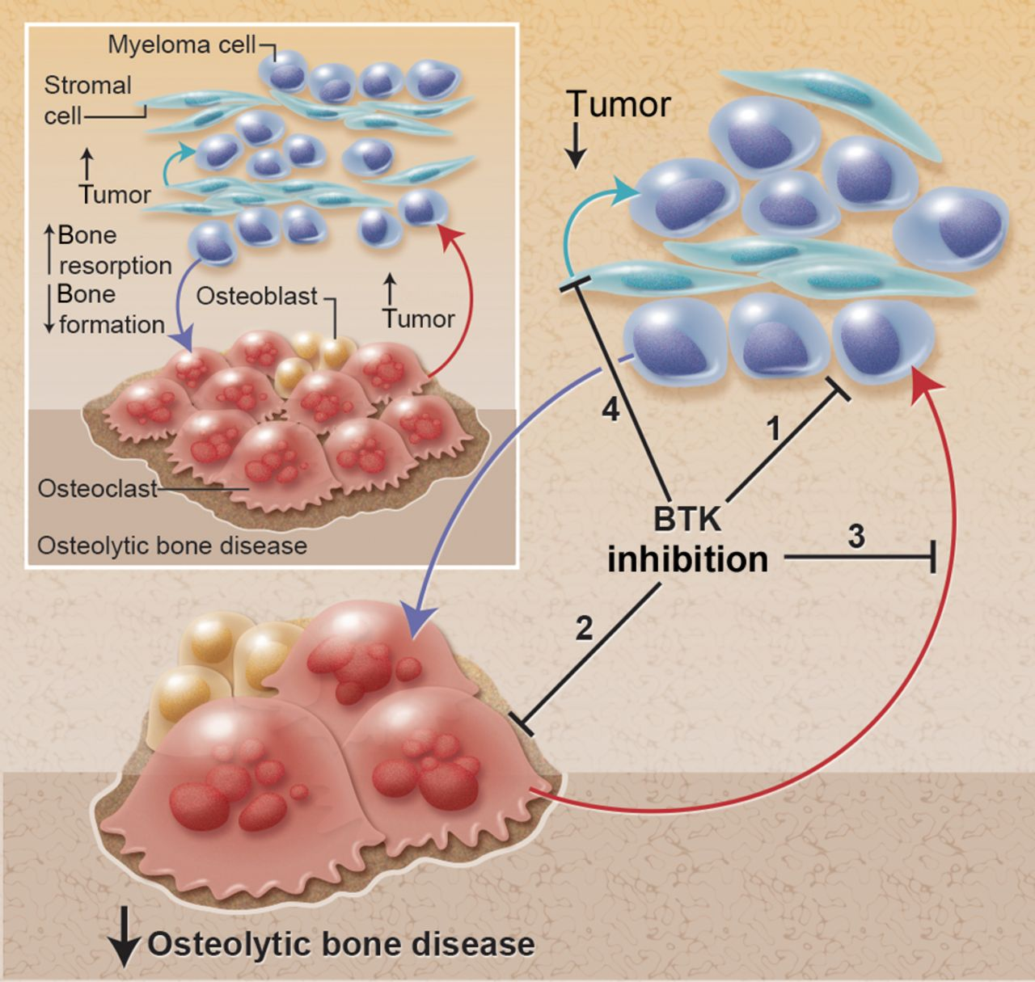
Effect of BTK Inhibition in the MM Microenvironment
Inhibits tumor growth
Reduced downstream NF-κB and STAT3
ERK1/2 and AKT signaling
Directly inhibits osteoclastic bone resorption and OC formation
Inhibits the release of osteoclast-derived tumor growth factors
Prevents adhesion to bone marrow stromal cells (BMSCs) and release of BMSC-derived growth factors
Reduced IL-6, SDF-1, BAFF, IL-8, M-CSF, and MIP-1
Edwards CM, et al. Blood. 2012;120(9):1757-1759.
Vij R, et al. Blood. 2014;124: Abstract 31.

Slide 6
PCYC-1111 Study Design
Cohort 3*
ibrutinib 840 mg PO daily
(n = 18)
Cohort 1*
ibrutinib 420 mg PO daily
(n = 13)
Cohort 2
ibrutinib 560 mg PO daily + Dex 40 mg weekly
(n = 18)
Cohort 4
ibrutinib 840 mg PO daily + Dex 40 mg weekly
(n = 20)
*For cohorts 1 and 3, addition of Dex 40 mg weekly permitted at disease progression per investigator discretion.
Phase II, open-label, nonrandomized, multicohort, multicenter study
Primary objective: clinical benefit rate defined as ≥MR by IMWG criteria¹
Secondary objectives: duration of clinical benefit, ORR (≥PR), duration of objective response, safety, and pharmacokinetics
1. Rajkumar SV, et al. Blood. 2011;117:4691-4695.
Vij R, et al. Blood. 2014;124: Abstract 31.

Slide 7
Key Eligibility Criteria
Inclusion Criteria
Exclusion Criteria
Measurable symptomatic MM
SPEP ≥0.5 g/dL
UPEP ≥200 mg/24 hours
sFLC: involved FLC level ≥10 mg/dL (≥100 mg/L)
Rel or Rel/Ref MM after receiving ≥2 lines of therapy, including an immunomodulatory agent
Refractory defined as nonresponsive (failure to achieve MR) while on treatment or PD within 60 days of last treatment
ECOG PS ≤1
Inadequate BM function
ANC <750 cells/μL
Platelets <50,000 cells/μL
Creatinine >2.5 mg/dL
Currently active, clinically significant cardiovascular disease (ie, uncontrolled arrhythmias, recent MI, NYHA class 3 or 4)
Peripheral neuropathy grade ≥2
Requires warfarin or other vitamin K antagonist (eg, phenprocoumon) or strong CYP3A4/5 inhibitors
Vij R, et al. Blood. 2014;124: Abstract 31.

Slide 8
Patient Characteristics
Characteristic | Cohort 1 (n = 13) | Cohort 2 (n = 18) | Cohort 3 (n = 18) | Cohort 4 (n = 20)
Median age, y (range) | 62 (49-74) | 66 (46-77) | 66 (54-81) | 65 (43-78)
Male, % | 62 | 50 | 72 | 55
ECOG PS 0/1, % | 54/46 | 33/67 | 44/56 | 35/65
Median time since Dx, y | 3.9 | 5.0 | 6.0 | 6.0
Measurable disease, %
SPEP/UPEP | 85 | 78 | 89 | 85
sFLC | 15 | 22 | 11 | 15
Disease status to last Tx, %
Relapsed | 31 | 17 | 11 | 20
Relapsed and refractory* | 69 | 83 | 89 | 80
*Refractory defined as either no response or progression on or within 60 days of the completion of therapy.
Vij R, et al. Blood. 2014;124: Abstract 31.

Slide 9
Prior Treatment Exposure
Cohort 1
Cohort 2
Cohort 3
Cohort 4
Patients, %
POM
CFZ
POM
CFZ
POM
CFZ
Median prior Tx (range) | 4 (2-10) |  | 4.5 (2-11) | 3 (2-14) | 4.5 (2-7)
SCT, % | 92 |  | 78 | 78 | 90
Vij R, et al. Blood. 2014;124: Abstract 31.

Slide 10
Prior Treatment Exposure
Cohort 1
Cohort 2
Cohort 3
Cohort 4
Patients, %
Median prior Tx (range) | 4 (2-10) |  | 4.5 (2-11) | 3 (2-14) | 4.5 (2-7)
SCT, % | 92 |  | 78 | 78 | 90
74% of patients received steroids in most recent therapy (all previously exposed)
Of 43 patients refractory to most recent Tx, 32 had steroids included in the regimen
Vij R, et al. Blood. 2014;124: Abstract 31.

Slide 11
Overall Response
Patients, %
CBR: 25%
CBR: 8%
CBR: 6%
Cohort 1
(n = 13)
Ibr 420 mg
Cohort 2
(n = 18)
Ibr 560 mg + Dex
Cohort 3
(n = 18)
Ibr 840 mg
Cohort 4
(n = 20)
Ibr 840 mg + Dex
Rate of disease stabilization or better increased with dose
CBR rate (≥ MR) was 25% for those treated in cohort 4
Vij R, et al. Blood. 2014;124: Abstract 31.

Slide 12
Progression-Free Survival
100
Cohort | 1 | 2 | 3 | 4
Median time, mo | 1.0 | 4.3 | 2.8 | 5.6
(Range) | (0.5, 21.2+) | (0.7, 5.8) | (0.4, 11.9+) | (0.0, 9.1+)
80
60
Progression-Free Survival, %
40
20
Cohorts 1, 2, and 3
Cohort 4
0
0
3
6
9
12
Months
Patients at risk
Cohorts 1, 2, and 3 | 49 | 8 | 1
Cohort 4 | 20 | 4 | 0
Vij R, et al. Blood. 2014;124: Abstract 31.

Slide 13
Progression-Free Survival
100
Cohort | 1 | 2 | 3 | 4
Median time, mo | 1.0 | 4.3 | 2.8 | 5.6
(Range) | (0.5, 21.2+) | (0.7, 5.8) | (0.4, 11.9+) | (0.0, 9.1+)
80
60
Progression-Free Survival, %
40
20
Cohorts 1, 2, and 3
Cohort 4
0
0
3
6
9
12
Months
Patients at risk
Cohorts 1, 2, and 3 | 49 | 8 | 1
Cohort 4 | 20 | 4 | 0
Vij R, et al. Blood. 2014;124: Abstract 31.

Slide 14
Progression-Free Survival
100
Cohort | 1 | 2 | 3 | 4
Median time, mo | 1.0 | 4.3 | 2.8 | 5.6
(Range) | (0.5, 21.2+) | (0.7, 5.8) | (0.4, 11.9+) | (0.0, 9.1+)
80
60
Progression-Free Survival, %
40
20
Cohorts 1, 2, and 3
Cohort 4
0
0
3
6
9
12
Months
Patients at risk
Cohorts 1, 2, and 3 | 49 | 8 | 1
Cohort 4 | 20 | 4 | 0
Vij R, et al. Blood. 2014;124: Abstract 31.

Slide 15
Progression Free Survival
100
80
≥ MR
100
60
Progression-Free Survival, %
40
SD > 4 months
80
20
0
0
3
6
9
12
60
Months
Progression-Free Survival, %
40
20
Cohorts 1, 2, and 3
Cohorts 1, 2, and 3
Cohort 4
0
0
0
3
6
9
12
Months
Patients at risk
Cohorts 1, 2, and 3 | 49 | 8 | 1
Cohort 4 | 20 | 4 | 0
Vij R, et al. Blood. 2014;124: Abstract 31.

Slide 16
Cohort 4: Efficacy Summary
Cohort 4 (840 mg + weekly Dex) achieved a 25% CBR (≥ MR) meeting cohort expansion criteria per Simon 2-stage design
25% achieved SD for ≥4 months despite actively progressing at the time of enrollment
Median of 4.5 prior lines of therapy
Responses and disease stabilization led to a median PFS of 5.6 months
4 patients remain on study treatment
Vij R, et al. Blood. 2014;124: Abstract 31.

Slide 17
Safety Summary
57% of patients experienced a ≥ grade 3 treatment-emergent AE
Treatment-emergent SAEs were reported in 33% of patients
Infection events ≥ grade 3 occurred in 19% of patients, without any specific event term occurring more frequently
22% of patients required a dose modification due to an AE, while 10% led to treatment discontinuation
Vij R, et al. Blood. 2014;124: Abstract 31.

Slide 18
Hematologic Adverse Events
Anemia
Thrombocytopenia
Neutropenia
Patients, %
Grade ≥3 febrile neutropenia occurred in 2.9% of patients
1 patient discontinued the study due to hematologic AE
Note: AEs associated with disease progression not included.
Vij R, et al. Blood. 2014;124: Abstract 31.

Slide 19
Nonhematologic Adverse Events (>20%)
Diarrhea
Dizziness
Fatigue
Muscle Spasms
Nausea
Arthralgia
Patients, %
Patients, %
6 patients discontinued the study due to nonhematologic AEs
Note: AEs associated with disease progression not included; back pain not included.
Vij R, et al. Blood. 2014;124: Abstract 31.

Slide 20
Patient Disposition
Disposition | Cohort 1 (n = 13) | Cohort 2 (n = 18) | Cohort 3 (n = 18) | Cohort 4 (n = 20)
On treatment | 8% | 0% | 11% | 20%
Discontinued treatment | 92% | 100% | 89% | 80%
PD | 38% | 61% | 56% | 40%
Investigator discretion | 23% | 33% | 17% | 10%
AE | 8% | 0% | 11% | 15%
Other* | 23% | 6% | 6% | 15%
* Includes patient withdrawal, noncompliance, and patient-required prohibited concomitant medication.
Vij R, et al. Blood. 2014;124: Abstract 31.

Slide 21
Conclusions
Safety profile was tolerable, with similar AE rates across dosing cohorts and consistent with those seen in other histologies
Ibrutinib ± weekly Dex demonstrated activity in this heavily pretreated relapsed and/or refractory MM population
Highest activity was seen in cohort 4 with:
25% CBR
Sustained SD in an additional 25%
Median PFS of 5.6 months
Enrollment of 23 additional patients in cohort 4 is complete; evaluation is ongoing
Vij R, et al. Blood. 2014;124: Abstract 31.

Slide 22
Future Directions
Further study of ibrutinib in combination with other backbone agents is warranted
A phase Ib/II trial of ibrutinib + CFZ has completed enrollment in the dose-escalation phase (NCT01962792)
Exploratory analysis of ibrutinib in patients with MM
Ibrutinib exposure in comparison with other B-cell malignancies
Impact of dexamethasone on ibrutinib exposure
Evaluation of potential predictive/prognostic biomarkers:
Bone metabolism, including sCTX, osteopontin, OPG (osteoprotegerin), sclerostin, RANKL
Microenvironmental cytokines and chemokines, including MDC (CCL22), IL-1, IL-4, SDF1 (CXCL12)
Hematopoietic markers, including Flt3L, GM-CSF
Vij R, et al. Blood. 2014;124: Abstract 31.

